Slide 1
Othello by Wiliam Shakespeare
Q3 WS2020

Slide 2
Content
topics
topic betrayal
history
story
main protagonists:
Othello
Desdemona
Iago (antagonist)
perception

Slide 3
topics
tragedy of sexual jealousy:
manhood
honour
confidence
racial prejudice
betrayal
sin: Christian values

Slide 4
topic betrayal
„betrayal“ of Desdemona:
toxic love of Othello
untrustfulness
ungrounded jealousy
emotional stress leads to violence
betrayal of Iago:
jealousy and envy as well as malevolence lead to revenge
Othellos career destroys Iagos honour

Slide 5
history
appeared in 1603, death of Elisabeth I
time of political and religious instability
historic events in the book: Venetian/Turkish conflict

Slide 6
story
relation of Othello and Desdemona
jealousy and influence of a relationship
Jago: soldier/ intrigue

Slide 7
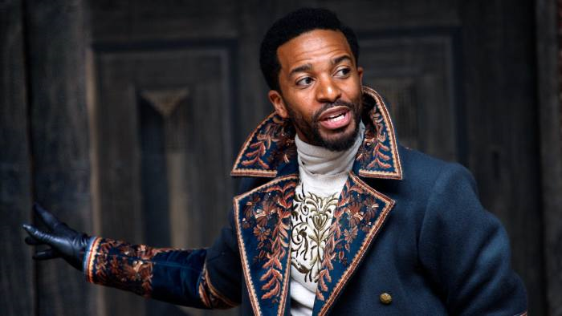
main protagonists
Othello:
black general
has a lot of influence in Venice/powerful person
married to a white wife, Desdemona
chief of Jargo/ he trusts in Jargo
racial outsider/ other culture
open minded but naive person
very emotional/ in love with his wife
physically powerful

Slide 8
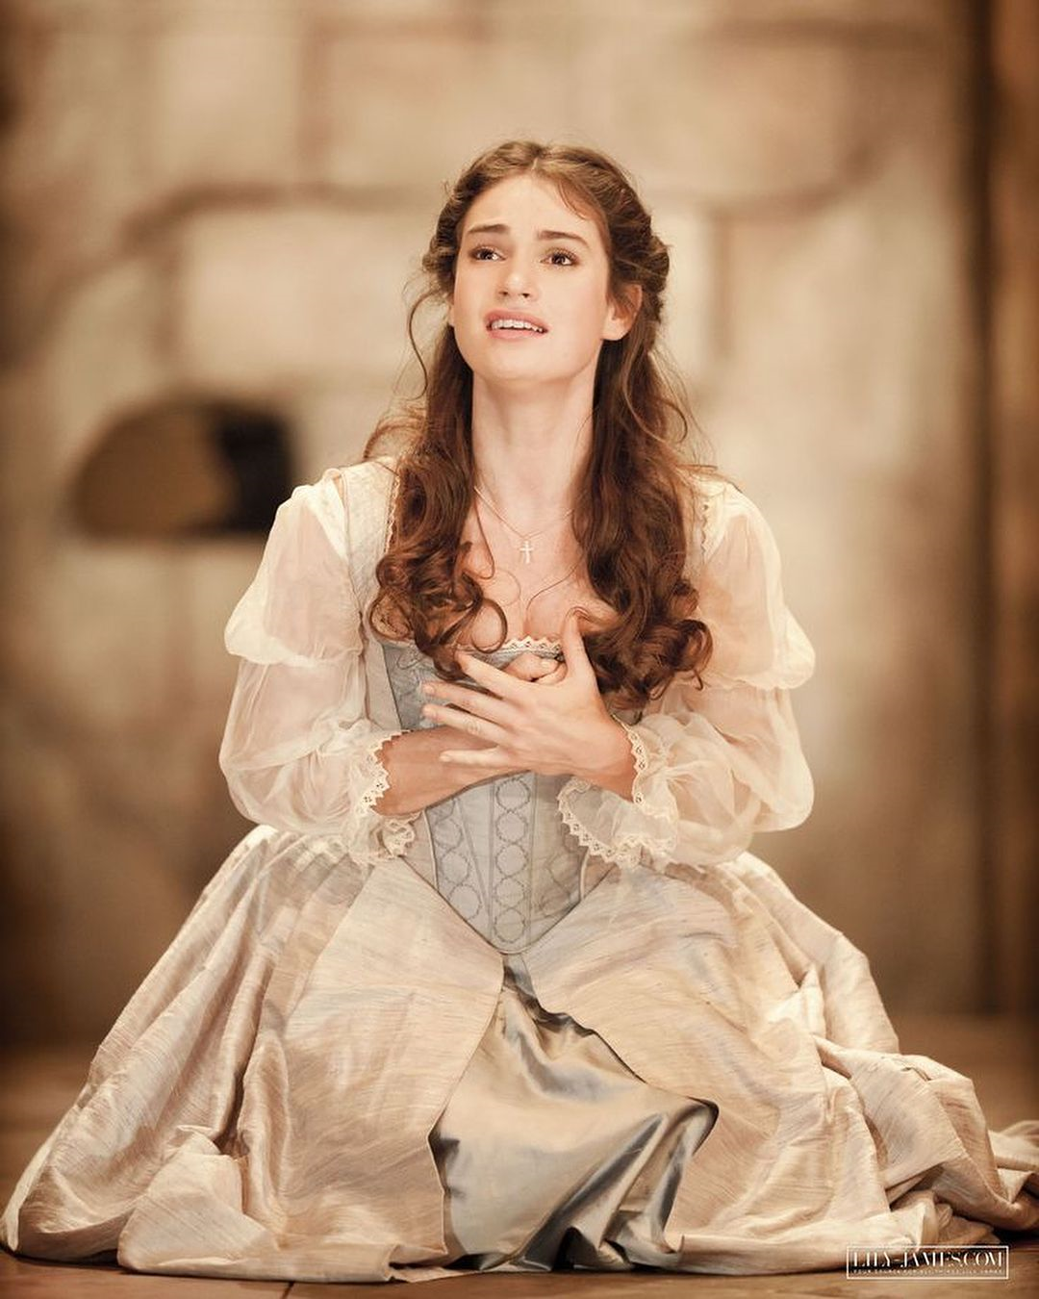
main protagonists
Desdemona:
she is loyal, does not betray Othello
daughter of the Venetian senator
she is beautiful
she depicts purity and independance
she will be killed by her husband

Slide 9
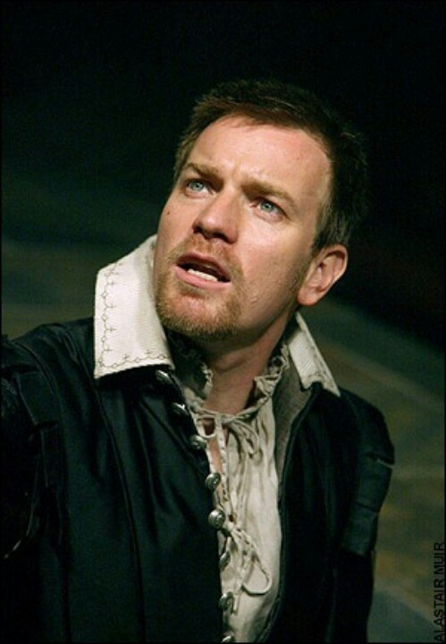
main protagonists
antagonist
Iago:
28 years old
serves under Othello
frustrated because he did not reach his aims
in his job
Othello made career instead of him
manipulative, destructive

Slide 10
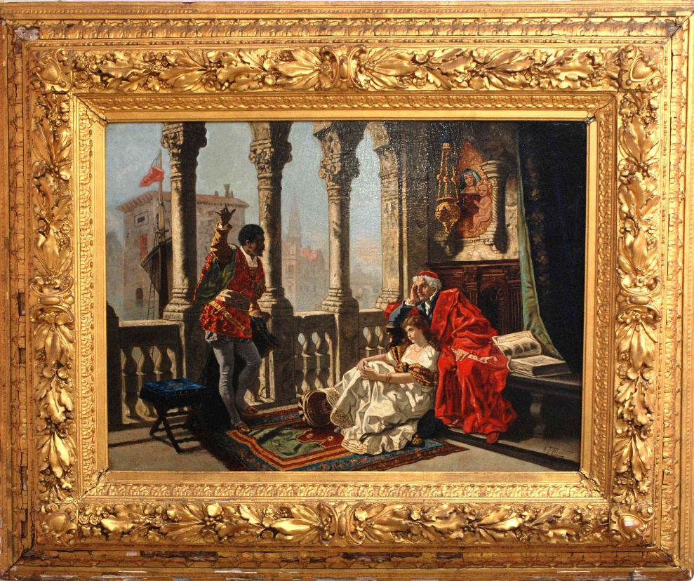
perception
released in 1603
debut performance: in 1604 in London (Whitehall)

Slide 11
Sources
https://antiqueogem.com/products/othello-relating-his-adventures-to-desdemona/
https://www.latimes.com/entertainment/arts/la-et-cm-old-globe-othello-review-20140701-column.html
https://www.ft.com/content/bb778854-9642-11e8-b747-fb1e803ee64e
https://www.pinterest.de/pin/539869074051472186/
https://www.pinterest.de/pin/407435097520456151/

