Slide 1
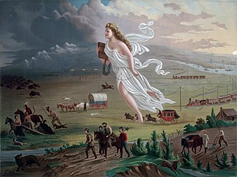
Manifest Destiny
SM

Slide 2
content
Columbia and Manifest Destiny
meaning of Manifest Destiny
image of the USA
mission of God´s own country
Manifest Destiny and the acquisition
expansion
purchases and wars

Slide 3
Meaning of Manifest Destiny
Ideology In the 19th century:
mix of national ambition and religious Christian belief
belief in God’s favour on American people

Slide 4
Columbia and Manifest Destiny
American Progress
by the painter John Gast in 1872
shows "Manifest Destiny"
scene of settlers moving west
Spirit of the Frontier
Columbia represents America

Slide 5
Columbia and Manifest Destiny
settlers are guided and protected by Columbia
dressed in a Roman toga
aided by technology (railways, telegraph)
Columbia is bringing the "light" and travels towards the "darkened" west. (“Enlightment”)

Slide 6
Meaning of Manifest Destiny
belief of the American settlers in their destiny
to expand across the continent previously inhabited by pagan Native Americans
to spread their traditions and their institutions
duty to spread democracy, freedom and Christianity
to enlight more primitive nations (like Indians and Hispanics)

Slide 7
Meaning of Manifest Destiny
used as a political tool
ideology lasted nearly a century

Slide 8
Image of the USA
the best organized country
example for the word
cultural and racial superiority

Slide 9
Mission of God´s own country
God blesses the growth of American nation
demanded of them to actively work on it
destiny to spread their rule around and enlighten the nations
mission to impose their virtuous way of life

Slide 10
Manifest Destiny anD the acquisition
served to explain the acquisition of territories
reason to go to war
a prime reason that the US citizens inhabited the western ends of North America
a driving force behind the near extinction of Native American tribes
used to support exploration and annexation of territories all the way to the western coast of California
example: war with Mexico in 1840s (played a key role in promoting the acquisition of the Texas state)

Slide 11
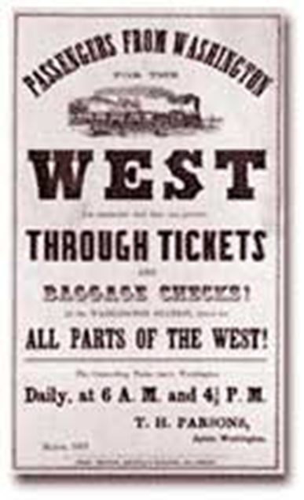
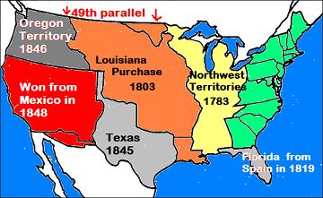
Expansion

Slide 12
Purchases and wars
Louisiana Purchase
Jefferson bought land from France, which doubled the size of the United States.
Florida
Spain gave Florida to the United States through a treaty.
Texas
Texas was added after it became an independent republic.

Slide 13
Purchases and wars
Oregon
The Oregon Territory was divided by the United States and Great Britain.
California
War with Mexico resulted in California and the southwest territory becoming part of the United States.

Slide 14
Sources
https://bestessayhelp.com/examples/history/american-history/manifest-destiny-in-1840s-america-essay-sample
http://www.historynet.com/manifest-destiny
http://www.ushistory.org/us/29.asp
http://www.solpass.org/6ss/Standards/standard_us1.8a.htm

Slide 15
Thank you!

