Slide 1
Mother to Mother Q2 SS 2020
@ TM Nur

Slide 2
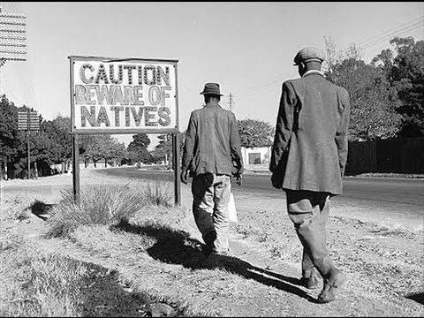
“Mother to Mother“
The book (Schader)
The author (Schader)
The background :
The apartheid system (Rau)
Main characters (Brems)
The relation of apartheid to the book: AmyBiehl (Brems)
Main topics (Harpe)
Writing and language of the book (Grey/Golnik)
The life conditions
The townships (Eftymiadou)
The Amy Biehl case (Harpe)
Sources (Kerner)
correction (Golnik) - pictures (Klein)

Slide 3
Cover of “Mother to Mother“
Beschriftung

Slide 4
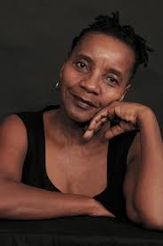
Sindiwe Magona
Sindiwe Magona
born 27 August 1943 in Gugululu (Transkei) South Africa
author
woman rights activist and social worker
Master of Science and Organisational Social Work
at the Columbus University
in New York
graduated from the University of South Africa

Slide 5
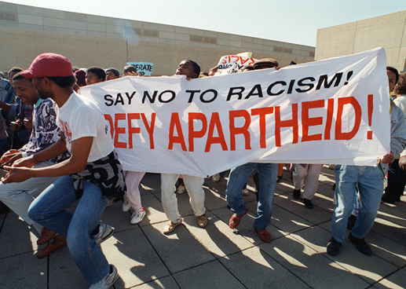
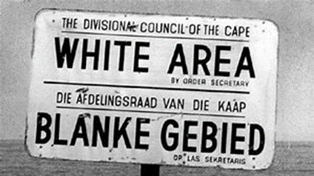
Apartheid in South Africa
“Apartheid” (separation in Afrikaans)
enforced racial discrimination and segregation in all areas of life:
→ dividing in four different groups and separation by law
→ “whites” had the supremacy over the others
officially made law in 1948
ended in 1994
Nelson Mandela was one of the main leaders
→ became the first black and democratically elected president, fought for equality and the end of Apartheid

Slide 6
Main characters: Mandisa and Mxolisi
Mandisa
is the first-person narrator
the mother of the murderer (Mxolisi)
has three kids by three husbands she writes a letter to Linda Biehl (Amy Biehl’s mother)
tells in her book about growing up with the Apartheid system
feels responsible for her son's behaviour
Mxolisi
Mandisas eldest son
Son of China
his origin name is “Hlumelo”
also had experience with the Apartheid system (his friends were killed by police)
is responsible for Amy Biehls death
is an anti-white activist

Slide 7
Main characters: Amy Biehl and Linda Biehl
Amy Biehl
was an anti-apartheid activist
was a scholar in the Fulbright Program
was a white American woman killed by a mob in Gugulethu
had friends from Cape Town
Linda Biehl
is the mother of Amy Biehl
is the receiver of Mandisas letters
isn’t directly mentioned in the book

Slide 8
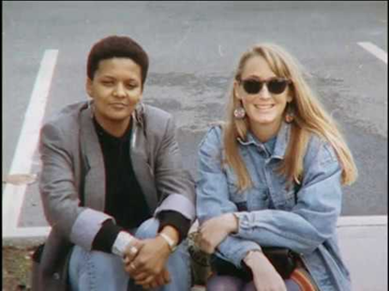
Amy Biehl case​ ​
American graduate of Stanford University
anti-Apartheid activist in South Africa​
murdered by Cape Town residents​
murderers were pardoned by the “Truth and Reconciliation Commission”​
Biehl's family supported the release of the men​
her death showed everybody the problems in South Africa​
August 25, 1993

Slide 9
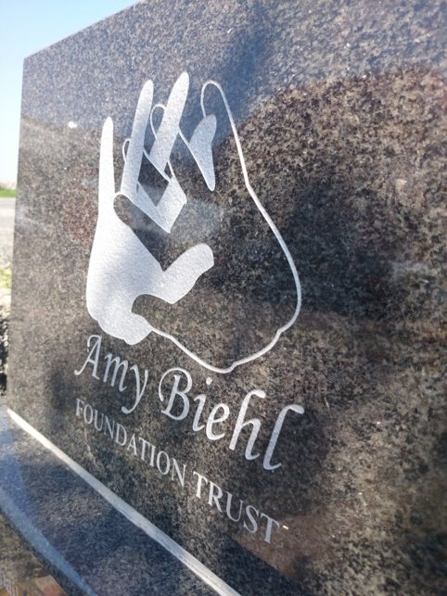
The Amy Biehl case
in 1994, Biehl's parents founded the Amy Biehl Foundation ​
developing and empowering youth in the townships​
in 1999, Biehl's parents were honored​ with the “Norman Felton Humanitarian- Award​”
in 2013, a ceremony was held​ (20th anniversary of her death)

Slide 10
Main topics of "Mother to Mother"
based on true story
Amy was killed during the Apartheid activism by a group of black natives (1993)
writer of the book is the mother of one of the murderers
writes about her life and the life of her child who committed this crime
describes and indicts the apartheid society that allowed this violence against Amy and the whites

Slide 11
Writing and languages of the book
written with many chants, prayers, songs, etc.
Xhosa (one origin language), English
letter: very emotional, less formal
Xhosa shows the roots of Mandisa much better, is spoken because whites shouldn’t understand it
languages split and connect multicultural societies

Slide 12
The townships
Township:
numerous housing estates for the colored
administered during the racial segregation policy
some of them are the size of medium and large cities
examples: Soweto (South Western Township), Mdantsane
“Bantustans” or “homelands”:
established by the Apartheid Government
majority of the Blacks population
prevention from living in the urban areas of South Africa.

Slide 13
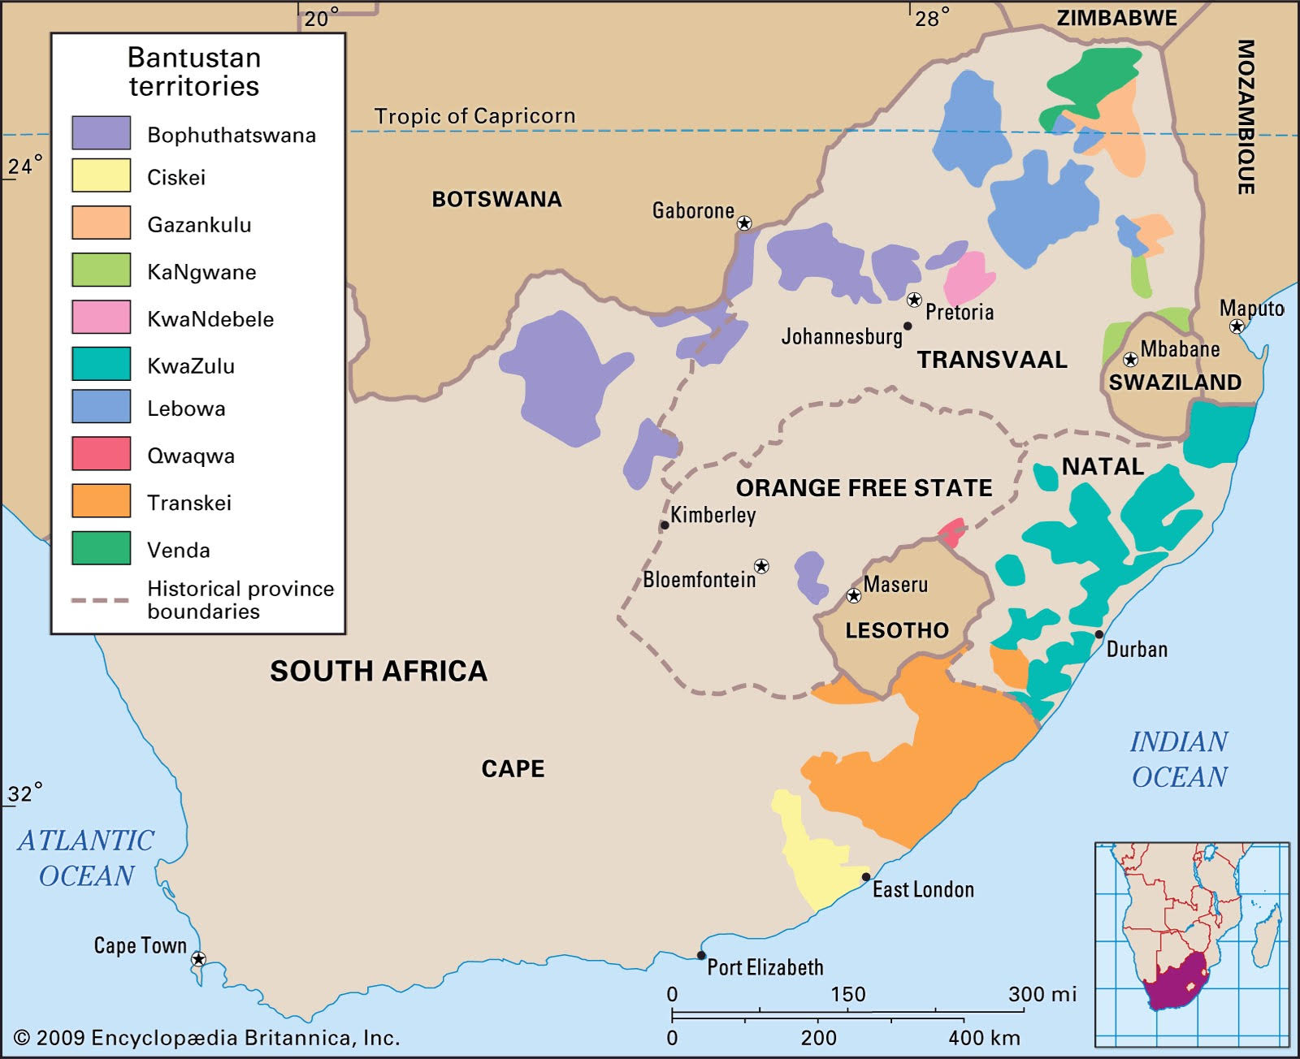
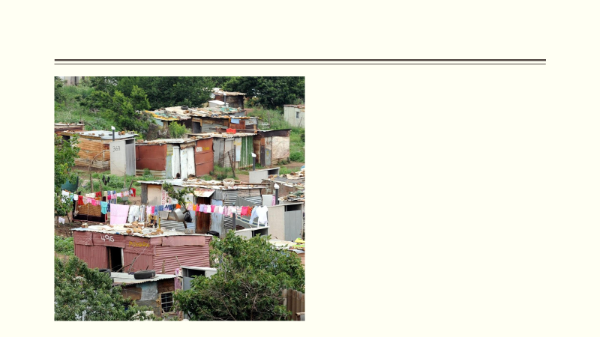

Slide 14
Sources:
Begleitheft zur Lektüre Mother to Mother p.16, 63, 64
https://www.nationalgeographic.com/culture/2019/04/how-south-africa-changed-since-apartheid-born-free-generation/
https://www.nytimes.com/1993/08/27/world/how-american-sister-died-in-a-township.html
https://www.planet-wissen.de/kultur/afrika/geschichte_suedafrikas/pwieapartheid100.html
https://www.klett-sprachen.de/sindiwe-magona/p-1/3515
https://de.wikipedia.org/wiki/Township_(S%C3%BCdafrika)
https://cmb-oase.de/media/image/product/2968/md/dnb-magona-mother-to-mother-tb.jpg
https://pbs.twimg.com/profile_images/684351510885601280/4rhr5LWR_400x400.jpg
https://upload.wikimedia.org/wikipedia/commons/thumb/c/ca/Bantustans_in_South_Africa.svg/1200px-Bantustans_in_South_Africa.svg.png

