Slide 1
When the yoghurt took over
Based on a short story by John scalzi
Presentation by Aaron Monye
English Q4

Slide 2
Content
world situation 2021
causes
future ?
humans can’t lead humans
utopia under a different form of life (Yoghurt)

Slide 3
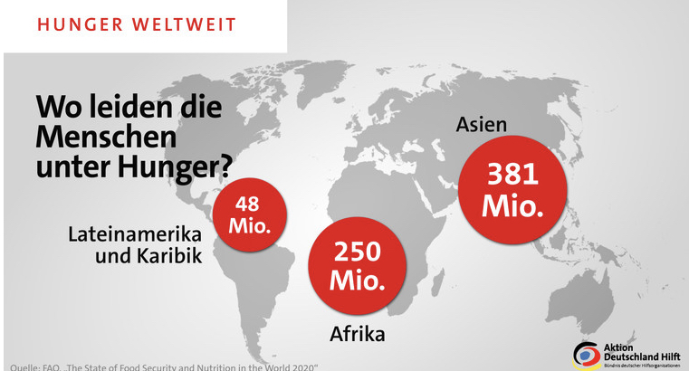
Poverty and hunger

Slide 4
Economic crisis
the Great Lockdown
Corona Crash
biggest stock market crash since 1987

Slide 5
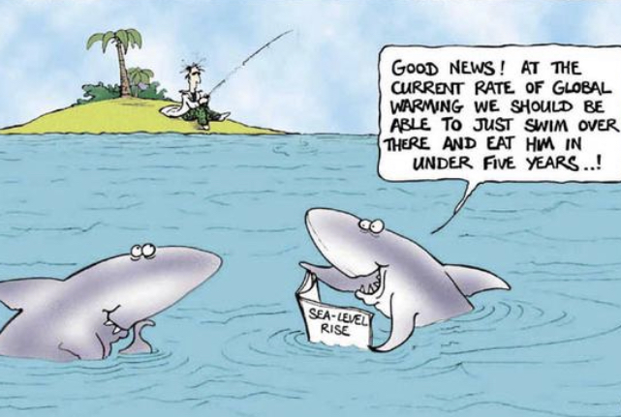
Climate change

Slide 6
Cold War
5G technology
Cold War between the US and China
“trade war”

Slide 7
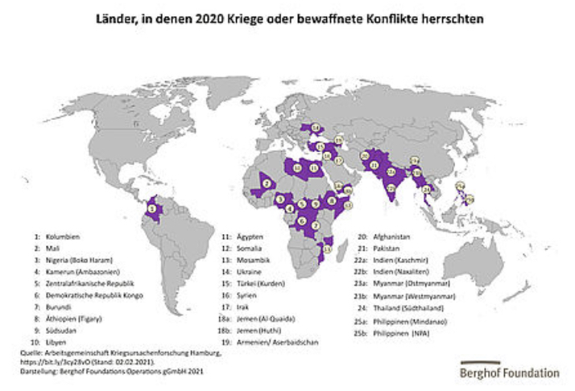
Terrorism and war

Slide 8
Racism and discrimination
5-10 people are victims of racism and discrimination daily (Germany)

Slide 9
Corona

Slide 10
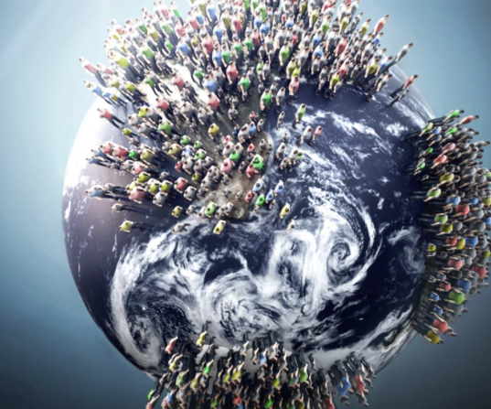
Causes
we need raw materials
increasing population
dissatisfaction
corruption

Slide 11
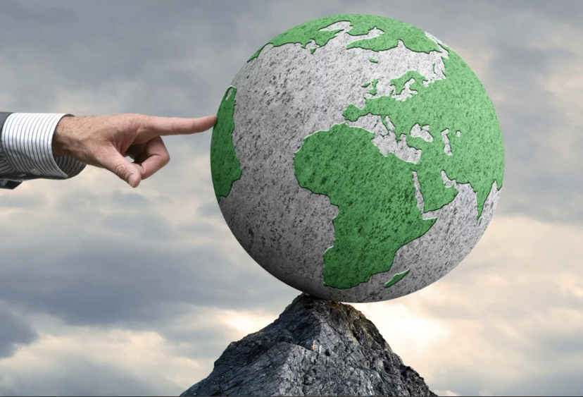
Future ?
more and dangerous diseases
more wars
economic crisis
natural disasters
division of society

Slide 12
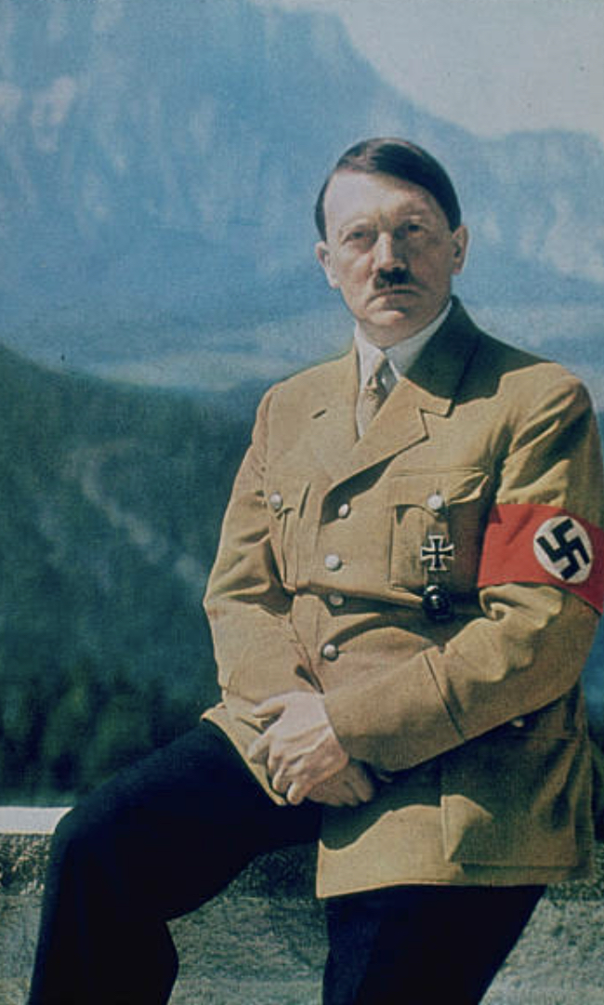
Humans can’t lead humans into a better world
first democracy 5th century before Christ
then wars and destruction
monarchies
dictatorships
kapitalism

Slide 13
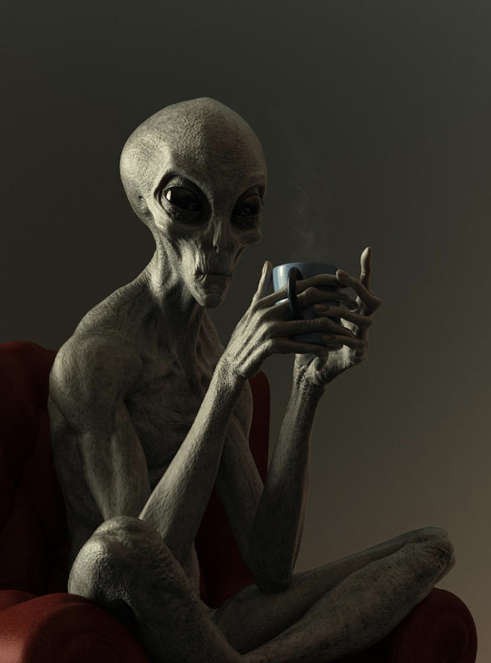
Aliens?
many people think they are real and already among us.

Slide 14
Yoghurt
a different life form lead us into a better life
without human emotions
everyone would be equal
everyone could be happy
no greed, envy or hate

Slide 15
Dystopia into utopia
people need to be convinced by showing that it can work
it needs time
wars would be avoidable
human beings don’t think rational

Slide 16
Utopia under the other life form
human beings are happy
everybody is equal
no economic crisises or property
no fear about their destiny (meaning of life)
feel safe and guided

Slide 17
But what if they would leave MEN behind ?

Slide 18
Sources
https://de.m.wikipedia.org/wiki/Wirtschaftskrise_2020–2021
https://www.leipzig.de/news/news/ergebnisse-der-klimawandel-umfrage-liegen-vor/
https://www.chinausfocus.com/finance-economy/trumps-war-on-huawei-will-ruin-americas-semiconductor-dominance
https://m.calcalistech.com/Article.aspx?guid=3833774
https://de.m.wikipedia.org/wiki/Terrorismus
https://www.frieden-fragen.de/entdecken/weltkarten/kriege-weltweit-2020.html
https://www.baden-wuerttemberg.de/de/service/presse/pressemitteilung/pid/kein-platz-fuer-rassismus-und-ausgrenzung
https://www.umweltbundesamt.de/en/topics/sustainability-strategies-international/what-does-the-corona-crisis-mean-for-environmental

Slide 19
Thank you for your attention …
But please waite I want to show you an episode!

