Slide 1
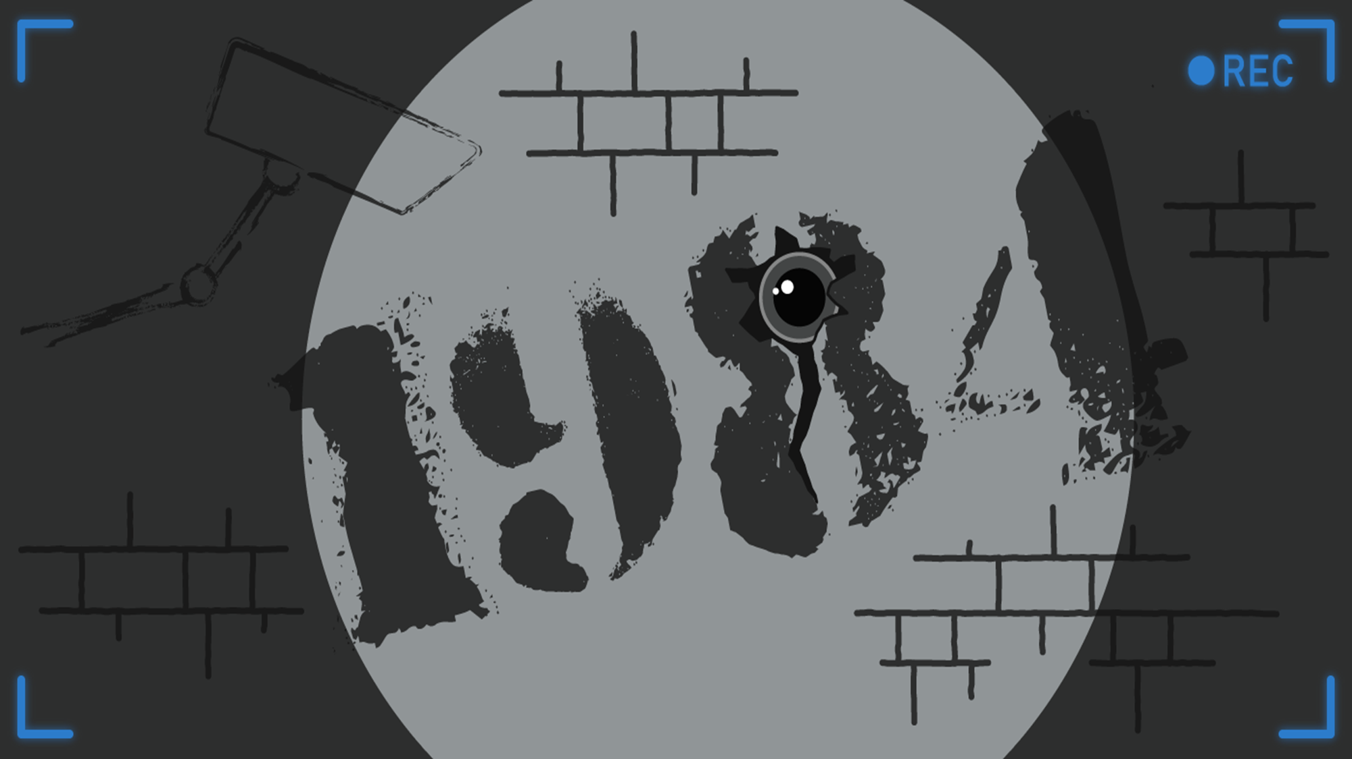
„1984“
a presentation by Tim Vaughan, Svenja Golnik & Markus Schreiter
https://www.youtube.com/watch?v=IcTP7YWPayU
Notes:
Refrain ab 1:18

Slide 2
Content
About „1984“
About the author
Important characters
Storyline (part I)
Storyline (part II+III)
O‘Brien tortures Winston (movie scene)
„The Big Brother“
„Newspeak“
Sources
Book cover “1984“

Slide 3
About „1984“
dystopic social science fiction-novel
author: George Orwell
year of appearance: 1949
place of appearance: Great Britain
is about a totalitarian police state in 1984

Slide 4
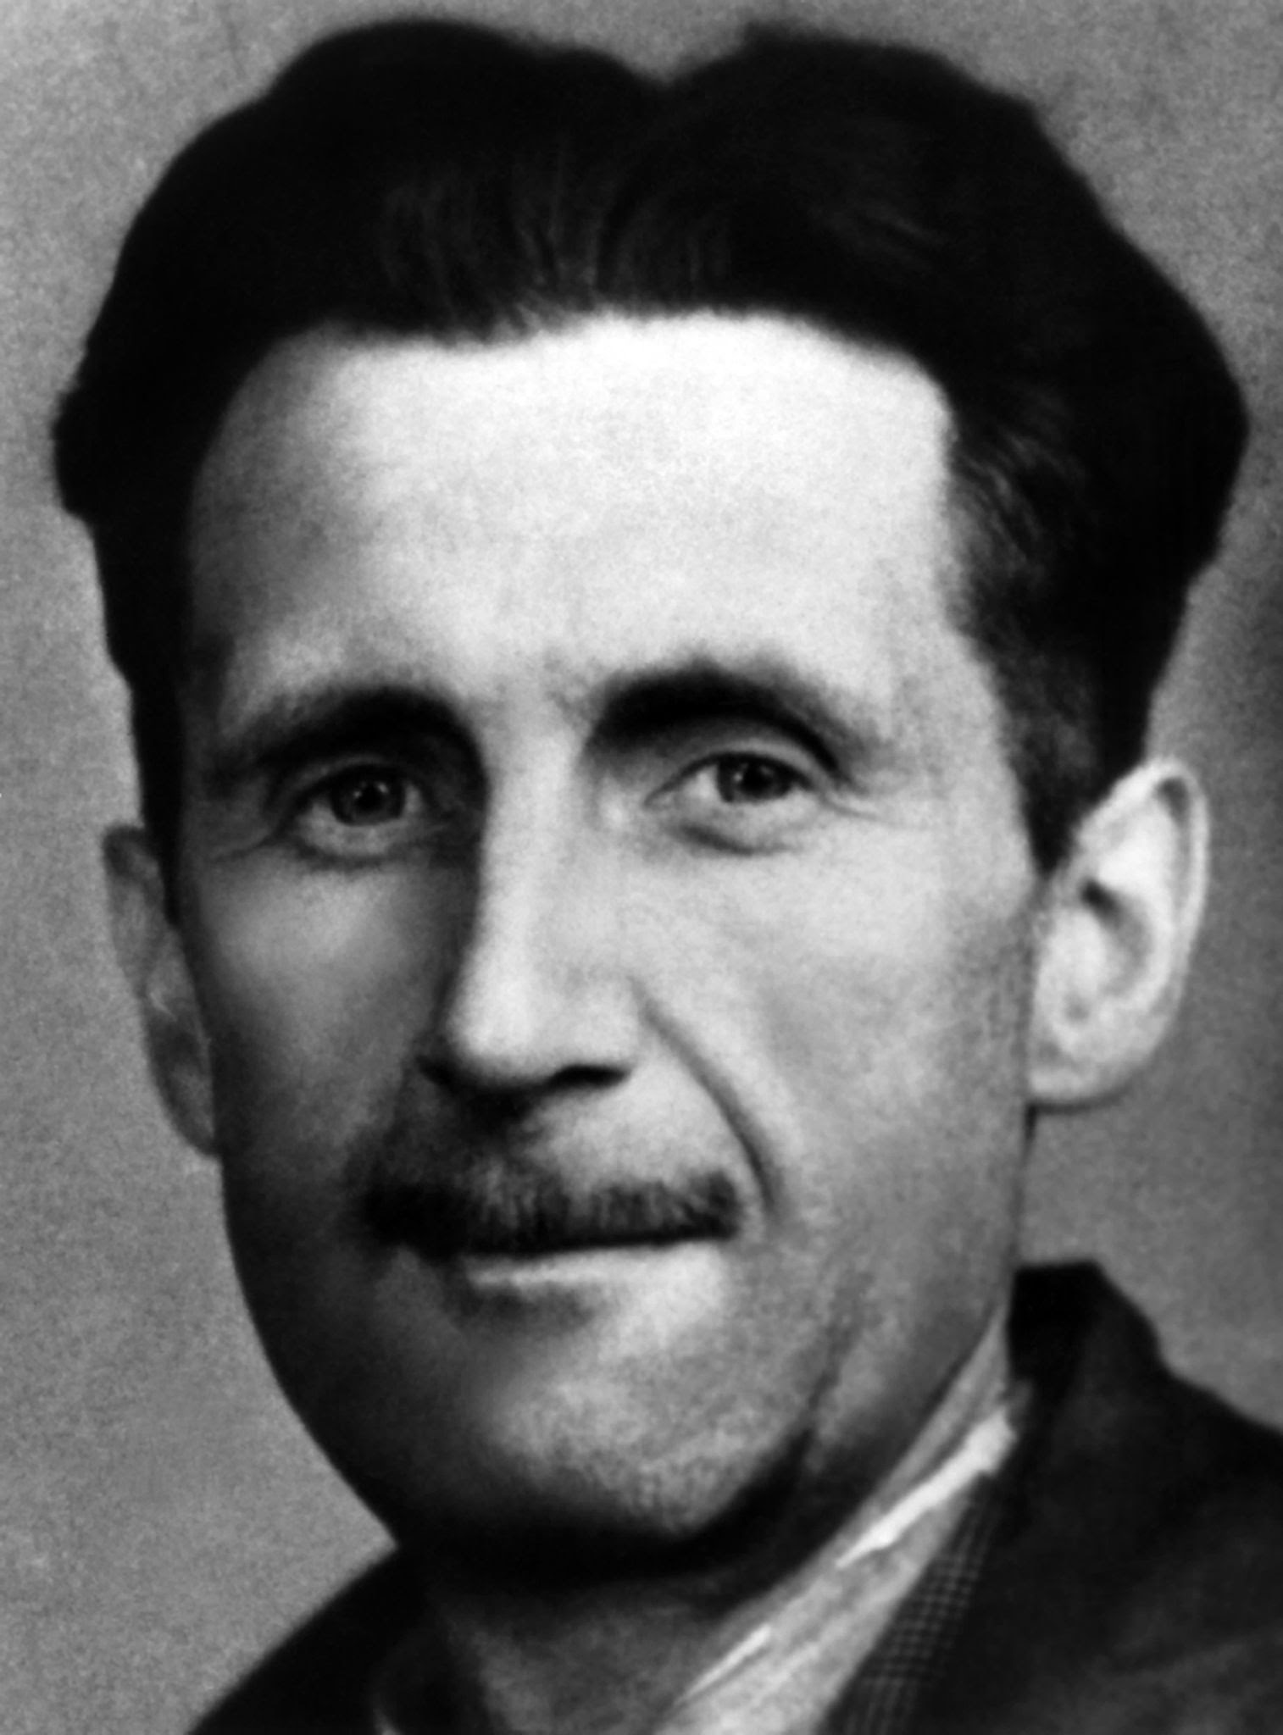
About the author
Eric Blair (pen name: George Orwell)
was born on the 25th June 1903 in India
education in Eton
died on the 21st January 1950
Picture of George Orwell

Slide 5
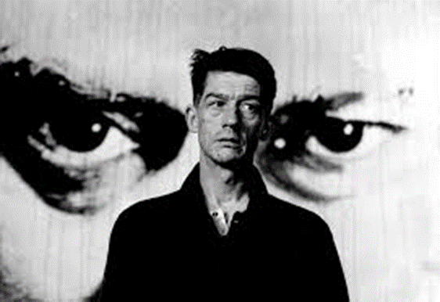
Important characters
Winston Smith -> protagonist
O‘Brien -> antagonist (traitor, member of the “thought police“)
Julia -> Winston‘s girlfriend (rebel against the system)
„The Big Brother“ -> leader of the state-party (dictator)
John Hurt as Winston Smith

Slide 6
Storyline (part I)
oligarchy system after atomic war (The „Big Brother“)
protagonist works for ministery of truth
member of a fictive state-party
recognizes the system
wants to protect his privacy but is afraid

Slide 7
Storyline (part II+III)
Part II:
sex is a crime
Julia wants relationship but Winston is afraid
relationship
Winston and her become arrested
Part III:
Winston and Julia are brainwashed and tortured by O‘Brien
after the manipulation: freedom but with vaporization

Slide 8
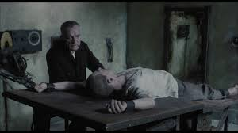
O‘Brien tortures Winston (movie scene)
https://www.youtube.com/watch?v=UmAVyowgDVE
picture of the scene

Slide 9
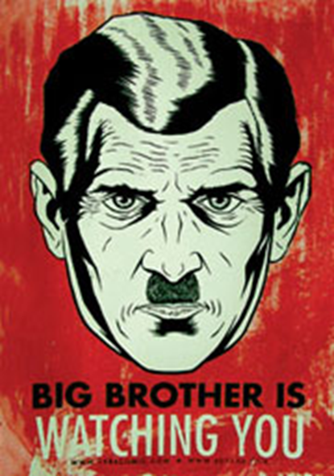
„The Big Brother“
„The Big Brother is watching you.“
leader of the state party in Oceania
totalitarian oligarchy
monitors the whole population
looks like a mixture between Hitler & Stalin
The „Big Brother“ and the symbol of the party

Slide 10
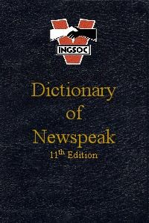
„Newspeak“
official language of Oceania
limitation of language
invention of new words
suspension of freedom & thinking
manipulation
eliminates undesirable words
should replace the original English
„Dictionary of Newspeak“

Slide 11
Sources
https://en.wikipedia.org/wiki/Nineteen_Eighty-Four
https://www.boxcryptor.com/de/blog/post/transparent-citizen-fiction-versus-reality-1984/
https://en.wikipedia.org/wiki/Newspeak
https://de-de.facebook.com/TheProjectorSG/posts/john-hurt-as-winston-smith-in-nineteen-eighty-four-1984-nineteen-eighty-four-is-/2002305286665342/
http://t0.gstatic.com/images?q=tbn:ANd9GcREqAv7AnJS-c8Qh1rrIOJW7516rze3EzJylqEssR4c4jOijPc4_JrGV-UgQJTX
http://rossblogthing.blogspot.com/2015/10/1984-torture-stages.html
https://www.pinterest.de/pin/262545853246992626/

Slide 12
Thank you for your attention!

