Slide 1
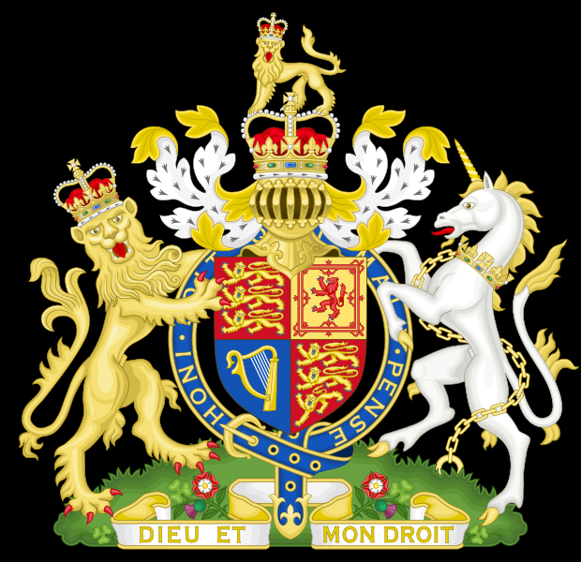
Monarchy of the United Kingdom
SM

Slide 2
Content
Kingdom
Monarch
Family-roots
Residences
Duties
History
Empire
End of Empire
Symbolism

Slide 3
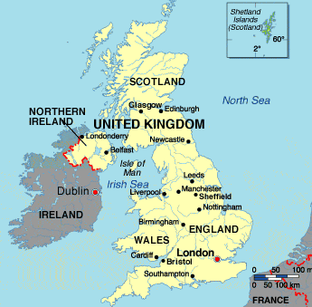
Kingdom
the constitutional monarchy of the United Kingdom
its dependencies
(Guernsey, Jersey and the Isle of Man)
and its overseas territories

Slide 4
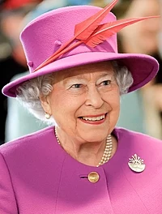
Monarch
constitutional monarchy
current monarch and head of state is Queen Elizabeth II
ascended the throne in 1952
the sovereign or "His/Her Majesty", abbreviated H.M.

Slide 5
Family- roots

Slide 6
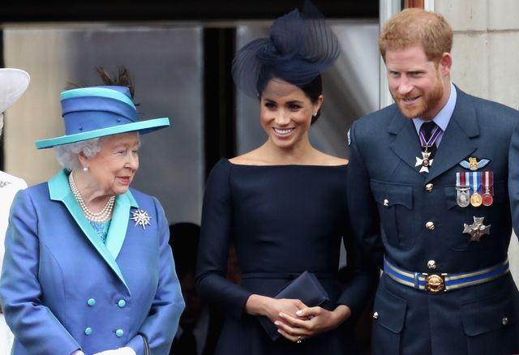
Family - roots

Slide 7
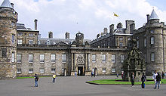
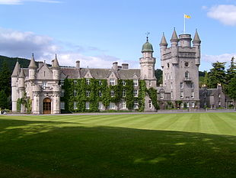
Residences
Balmoral, summer residence
Holyrood Palace, the Scottish residence
Buckingham Palace,
the monarch's principal residence

Slide 8
Duties
the ultimate executive authority over the government
the Government of the United Kingdom is known as Her (His) Majesty's Government
appointing the prime minister
the Queen is commander-in-chief of the British Armed Forces
Head of the Church of England

Slide 9
Duties
Magna Carta 1215: reduced the English monarch's political powers
various official, ceremonial, diplomatic and representational duties
limited to functions such as bestowing honours
little direct part in government
the Queen's Speech
the State Opening of Parliament

Slide 10
Duties
Palace of Westminster

Slide 11
History
medieval Scotland and Anglo-Saxon England
conquered by the Normans in 1066
Wales came under control of Anglo-Normans
in 1707, the kingdoms of England and Scotland were merged to create the Kingdom of Great Britain
in 1801, the Kingdom of Ireland joined to create the United Kingdom of Great Britain and Ireland
the British Empire covered a quarter of the world's land area at its greatest extent in 1921

Slide 12
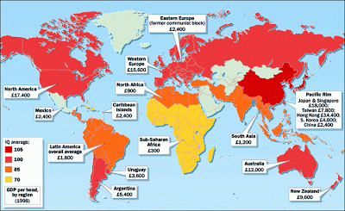
Empire

Slide 13
End of the Empire
1920s the Balfour Declaration: Dominions of the Empire became self-governing countries within a Commonwealth of Nations
after the Second World War, the vast majority of British colonies and territories became independent
George VI and his successor, Elizabeth II, adopted the title Head of the Commonwealth
the United Kingdom and fifteen other independent sovereign states are called Commonwealth realms
each country is sovereign and independent of the others
the monarch has a different, specific, and official national title and style for each realm

Slide 14
Symbolism
the monarch as head of state
government authority
mentioned in and the subject of songs, loyal toasts, and salutes: "God Save the Queen"
and in the British national anthem

Slide 15
Sources
text:
https://en.wikipedia.org/wiki/Monarchy_of_the_United_Kingdom
https://www.theweek.co.uk/104474/the-most-popular-british-royals-in-2020
pictures:
https://en.wikipedia.org/wiki/File:Wfm_holyrood_palace.jpg
https://en.wikipedia.org/wiki/Monarchy_of_the_United_Kingdom#/media/File:Buckingham_Palace_2007_2.jpg
https://www.lz.de/_em_daten/_cache/image/1xHjEYTjxUXztLuOJ1oxpM7B2x8DraFIIcXad59u2APRsUueg2aajEJHHXd1PT3qL1i7T9OwEFPYhkusFjed1-56y4lqCuBHhJEPix2e8zytk/160421-1500-die-royals-koeniglic-49024705.jpg
https://pbs.twimg.com/profile_images/1044061985581805569/F_BUyyzN.jpg
https://www.laenderservice.de/wappen/europa/vereinigtes_koenigreich/_media/Wappen_UK.png
http://projectbritain.com/britain/uk.htm
https://www.royal.uk/state-opening-parliament
https://www.theweek.co.uk/104474/the-most-popular-british-royals-in-2020

