Slide 1
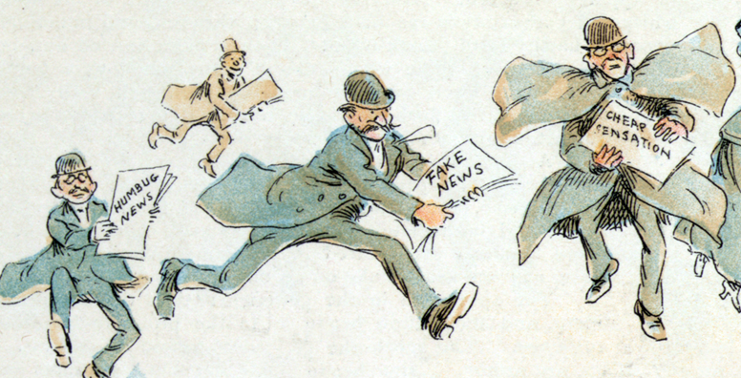
Fake News
1894 illustration by Frederick Burr Opper
SM/Q4

Slide 2
content
Definition
Aim
Spread
Example
Publication
Problem
Types
Recognizing
Believe it or not
Sources
Thank

Slide 3
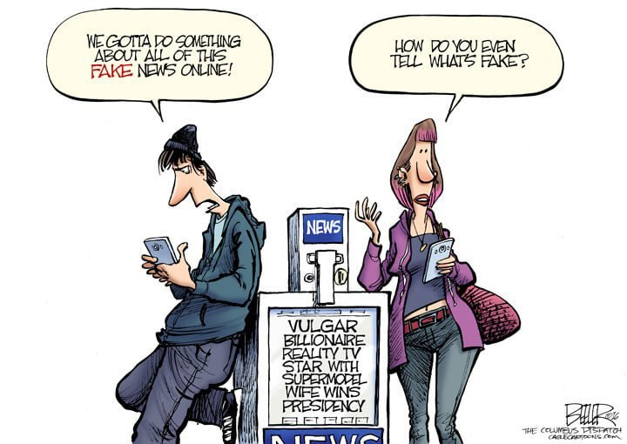
Definition
`Fake news`
is false or misleading information presented as news

Slide 4
Aim
damaging the reputation of a person or entity
making money through advertising

Slide 5
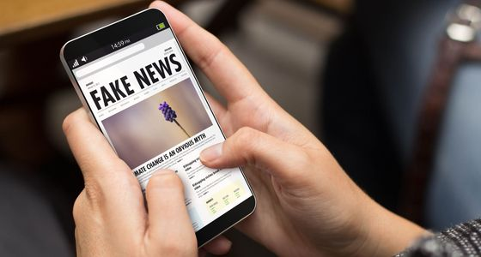
Spread
spoken
written
printed
electronic or
digital communication

Slide 6
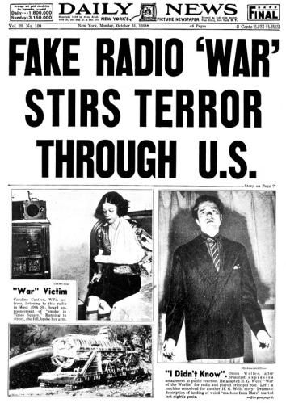
ExamplE
Orson Wells Radio Fake News

Slide 7
Publication
increased with the rise of social media:`: `Facebook`, `Twitter`, Ìnstagram …
social media algorithms have been implicated in the spread of fake news
it is sometimes generated and propagated by hostile foreign actors
particularly during eletions
fake news websites
satirical articles misinterpreted as genuine („Postillion“)
sensationalist headlines that are not supported in the text („Bild“)

Slide 8
Problem
Why fake news is a problem:
fake news or have no basis in fact, but are presented as being factually accurate
That´s why it
can reduce the impact of real news by competing with it
can undermine trust in serious media coverage
(doubt upon legitimate news „Donald Trumps“description of any negative
press)

Slide 9
Types
a few examples of fake news:
propaganda
satire/parody
misleading headings
manipulation
misinformation

Slide 10
Misinformation
Fish market or bioweapons laboratory?
Fact (up to now) SARS-CoV-2 broke out for the first time in a Chinese fish market
Fake theory: the virus is a biological weapon developed in secret Chinese laboratories
speculations are based on the book "The Eyes of Darkness", which was published in 1981 by Dean Koontz
It describes a biological weapon called Wuhan-400 developed in laboratories outside the Chinese city of Wuhan (a laboratory city).

Slide 11
Propaganda
`Tales of a stolen election have fallen by 73 percent after Twitter and various other platforms banned the incumbent president.`
MEEDIA EDITORIAL TEAM
JANUARY 18, 2021

Slide 12
recognizinG
Consider the source, its mission and purpose
Read beyond the headline
Check the authors (credibility)
Check the date of publication
Could it be a satire (Orson Wells: radio report about the Marsians )
Ask experts (independent knowledge)

Slide 13
Believe it or not

Slide 14
Sources
https://de.wikipedia.org/wiki/Fake_News
https://www.neh.gov/article/fake-news-orson-welles-war-worlds-80
published as "The Fake News of Orson Welles: The War of the Worlds at 80" in the Fall 2018 issue of Humanities magazine, a publication of the National Endowment for the Humanities.”
https://www.pinterest.de/amexperiencepbs/war-of-the-worlds/
https://www.aerzteblatt.de/nachrichten/111092/Die-Pandemie-der-Fake-News
https://www.tagesanzeiger.ch/ausland/amerika/wer-entscheidet-was-fakenews-sind-und-was-nicht/story/30714702
https://www.laprogressive.com/fake-news-definition
https://bildblog.de/search/falschmeldung/

Slide 15
Thank you!

